Slide 1
Cryptography for Ecommerce Part 2
CSCI 6548
Kevin Yasuda

Slide 2
SSL/TLS History
A protocol developed over 10 years ago
One name change
One ownership change
Most used version is SSLv3/TLS 1.0
Most current version is TLS 1.2

Slide 3
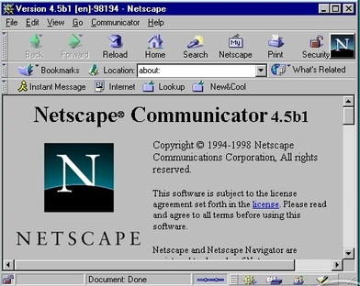
SSLv2
1995 SSLv2 first public draft released
Submitted by Kipp Hickman of Netscape Communications
Submitted to the IETF
Rejected by the IETF
Had several flaws
Not considered safe to use for credit card information by the Payment Card Industry

Slide 4
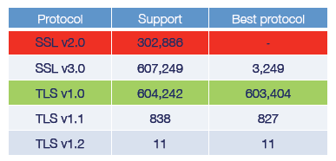
SSLv3 and TLS 1.0
SSLv3 submitted to the IETF
A few changes made (mostly superficial)
Changed name to TLS 1.0
Versions in the protocol still follow SSL versions
Made TLS 1.0 interoperable with SSLv3
TLS 1.0 specified in RFC 2246
SSLv3 is not interoperable with TLS 1.0
Both SSLv3 and TLS 1.0 are widely used
Trusted Servers SSL Support
(Qualys SSL Labs, Blackhat, 2010)

Slide 5
TLS 1.1 and 1.2
TLS 1.1 released in 2006
RFC 4363
Added protection against CBC attacks
TLS 1.2 released in 2008
RFC 5246
Replacement of MD5 hashes with SHA
More encryption support

Slide 6
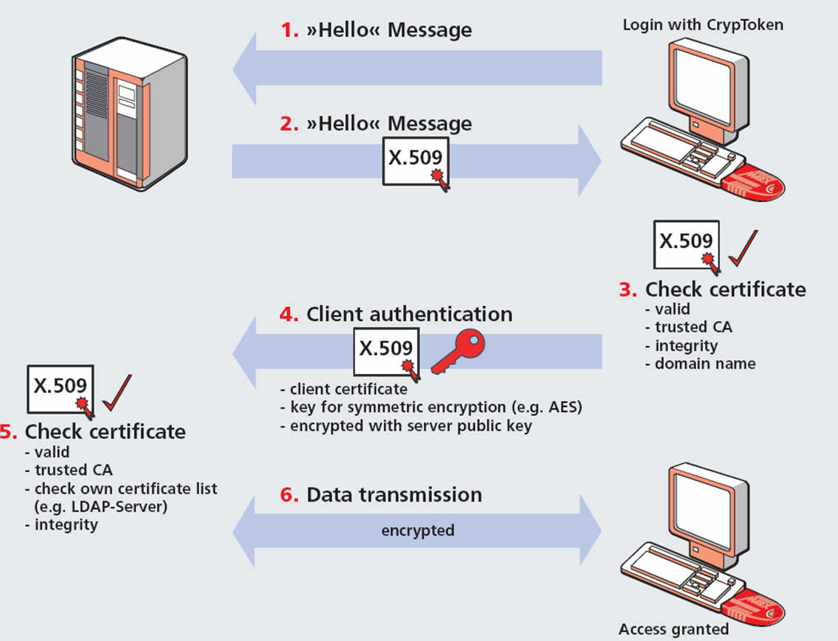
SSL/TLS Basic Operation

Slide 7
HTTP over SSL
SSL or TLS specifications do not specify how clients tell a web server they want to talk over SSL
Eric Rescorla submitted RFC 2818 to formalize it
Web servers use a different TCP port (443) to accept HTTP over SSL connections
Browsers allow users to specify SSL via ‘https’ syntax
Notes:
Eric Rescorla is Author of “SSL and TLS: Designing and building Secure Systems” well read book on ssl/tls.

Slide 8
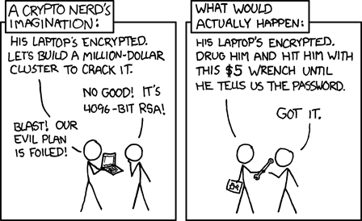
SSL/TLS Overview
The following is an overview of the protocol
Many of the optional steps have been omitted for brevity
xkcd.com

Slide 9
SSL/TLS Header: Plaintext Header
All SSL/TLS messages are pre-pended by this header to describe its type and length
Types
Change cipher spec = 20
Alert = 21
Handshake = 22
Application data = 23

Slide 10
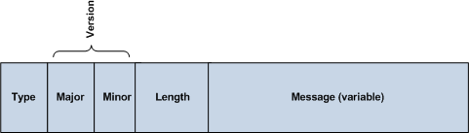
Plaintext Header Structure

Slide 11
SSL/TLS Header: Handshake Header Fields
Message type
Different handshake steps have different IDs
Length
24 bit length of handshake message field
Handshake message body
The contents, variable depending on the message type
Notes:
Type 22

Slide 12
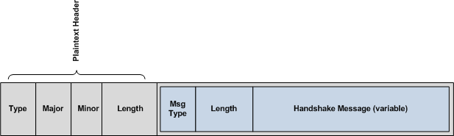
Handshake Header Structure (inside plaintext header)

Slide 13
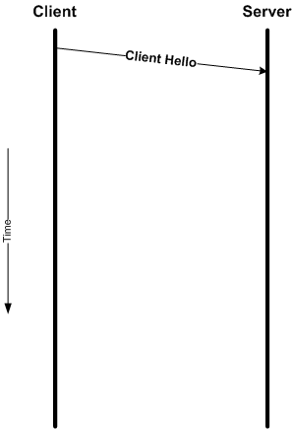
SSL/TLS Client Hello
Client is responsible for starting things
Client Hello is the first thing sent
Client Hello structure:
Typedef struct {
Protocol Version;
random;
sesson ID length;
*session ID;
Cipher Suites Length;
*Cipher Suites;
Compression Methods Length;
*Compression Methods;
} clientHello

Slide 14
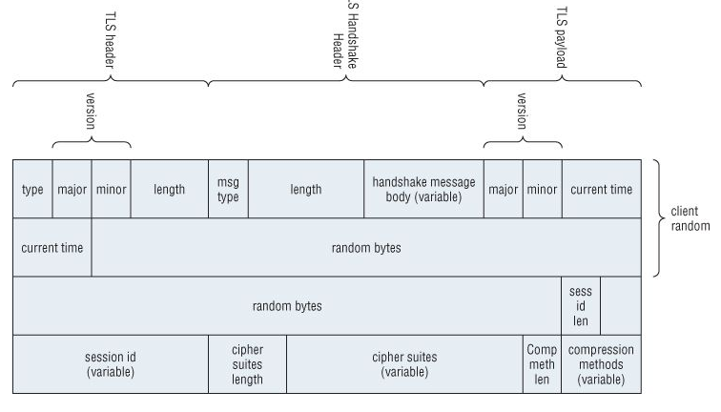
Client Hello Structure (with headers)

Slide 15
Client Hello
A blank session ID means the client is requesting a new session
The Random value is mandated to contain the first 4 bytes be UNIX time
Compression is optional – may specify “no compression”
If compression is used, it must be used before encryption

Slide 16
Cipher Suites
Client specifies which cipher suites it supports
Cipher suites are defined with a Asymmetric Crypto + Symmetric Crypto + Secure Hash Algorithm
Examples:
TLS_NULL_WITH_NULL_NULL = 0x000
TLS_RSA_WITH_RC4_128_SHA = 0x0005
TLS_RSA_WITH_DES_CBC_SHA = 0x0009
TSL_RSA_WITH_3DES_EDE_CBC_SHA = 0x000A
TLS_DH_RSA_WITH_DES_CBC_SHA = 0x000F
....etc…

Slide 17
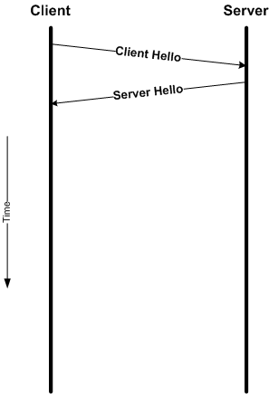
SSL/TLS Server Hello
Server picks which options to use
Selects the SSL/TLS version
Selects which cipher suite to use
Selects which compression method to use
Assigns a session ID
Provides a random value

Slide 18
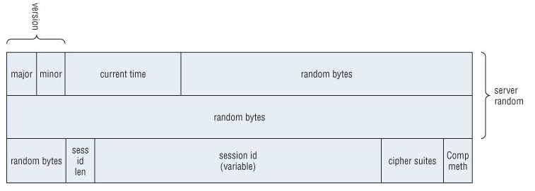
Server Hello Structure (without headers)

Slide 19
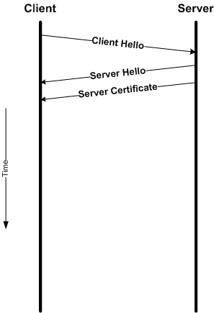
SSL/TLS Certificate
Server sends its certificate after the Hello message
Provides the server’s identity
Provides the server’s public key
This is dependant on what was selected in the previous Hello message
i.e. DH, RSA, DH w/ RSA, etc.
May be more than one certificate (i.e. the cert chain)

Slide 20
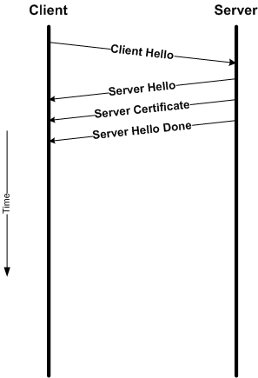
SSL/TLS Server Hello Done
Indicates the server will no longer send handshake messages
Handshake type 0x0E
Client verifies certificate before continuing

Slide 21
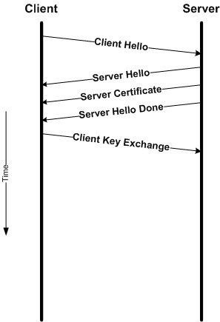
SSL/TLS ClientKeyExchange
Client uses server’s public key to encrypt and send a preMaster Secret value
Used to prevent vulnerabilities in secret generation
Used as a seed to prevent replay attacks

Slide 22
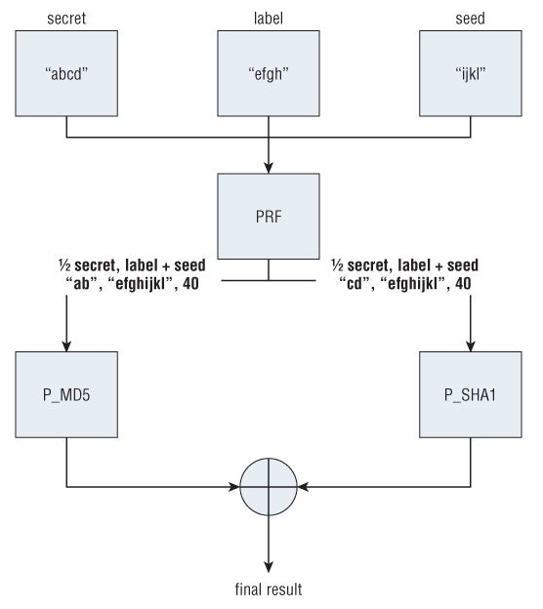
PreMaster Secret to Master Secret
Use a pseudo random number generator (PRNG) to create a secret
Based on the required hash functions MD5 and SHA1
PRNG splits the premaster secret between MD5 and SHA1
Each hash function is run multiple times to generate enough output
Output is XOR’ed together

Slide 23
PreMaster Secret to Master Secret
PRNG’s three inputs
The secret is passed via the client key exchange
The label is hardcoded string “master secret”
The seed is the Client Random + Server Random
This prevents replay attacks
PRNG output is a 48-byte master secret
The master secret is used to derive keying material
If a encryption cipher needs more than 48-bytes of key material (e.g. AES 256) the PNG is used on the master secret
The label changes to “key expansion”

Slide 24
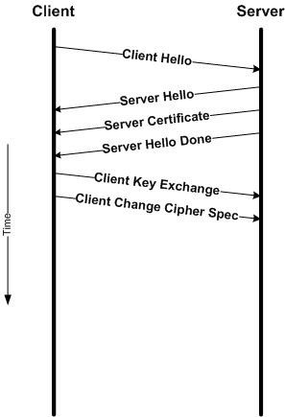
SSL/TLS Client Change Cipher Spec
Marker message to indicate key exchange has completed
Everything sent will now be encrypted
Client still listens in unencrypted mode (for server’s response)
This message is not a handshake message (although only happens in the context of a handshake)
“To help avoid pipeline stalls, ChangeCipherSpec is an independent TLS Protocol content type, and is not actually a TLS handshake message.” (RFC 2246)
Notes:
Pipeline stalls… not well explained in the RFC. Deduce that they didn’t want non-handshake messages to be bundled together.

Slide 25
Client Change Cipher Spec
struct {
enum { change_cipher_spec(1), (255) } type;
} ChangeCipherSpec;

Slide 26
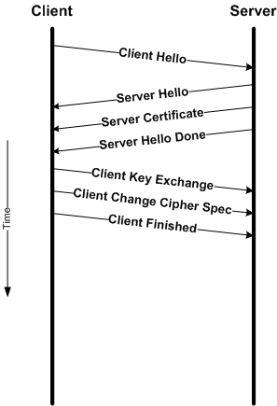
SSL/TLS Finished
An 12 byte hash value of the content of the handshake is sent
This is to prevent MITM attacks on the handshake
An issue with SSLv2
This is the first encrypted message using the agreed upon parameters

Slide 27
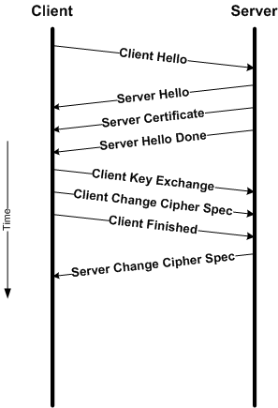
SSL/TLS Server Change Cipher Spec
Server replies with its own key exchange confirmation

Slide 28
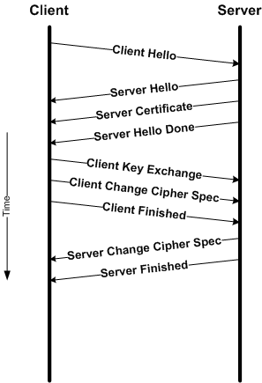
SSL/TLS Server Finished
Server replies with its own finished message
First encrypted message sent by the server

Slide 29
SSL/TLS Sending Data Securely
MAC is used to provide message integrity
The MAC value is appended to the message
Sequence numbers are assigned to each message
To prevent replay attacks
Sequence numbers start at 0 after a change cipher spec message, and increment on send/recv
Included in the MAC but not sent
Notes:
(MAC) Message Authentication Code, in TLS Hash MAC used.
Sequence number maintained by both sides – prepended for the MAC

Slide 30
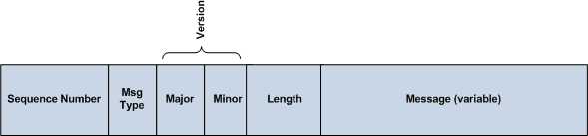
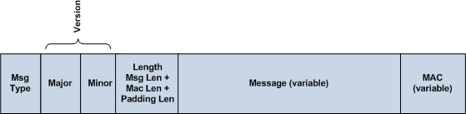
SSL/TLS Sending Data Securely
Above is what is MAC’ed
Below is what is sent encrypted

Slide 31
SSL/TLS Shutdown
When a party wants to end the connection they sent an Alert message with code 0 (close-notify)
SSLv2 had no authenticated shutdown message any connection could be closed with a TCP FIN packet

Slide 32
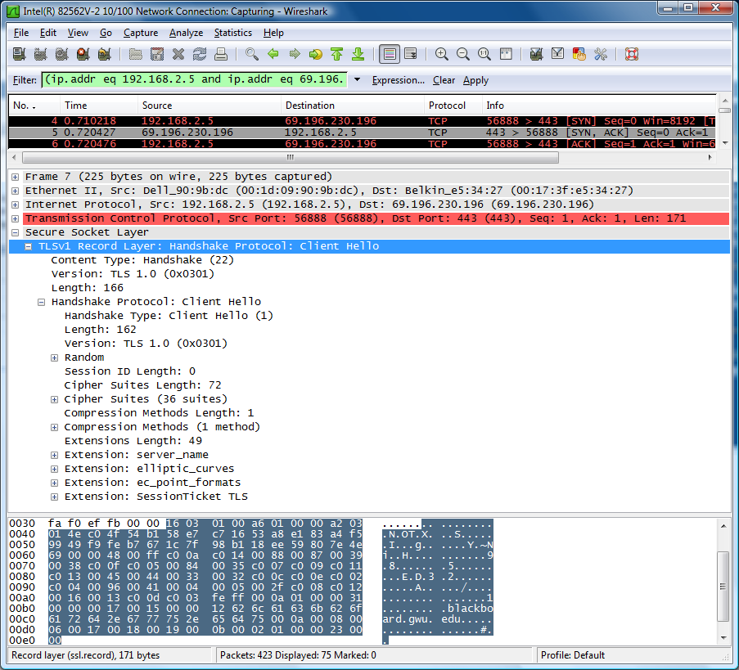
Walkthrough a TLS Connection: Client Hello
Client hello
Highest available version is TLS 1.0
36 Cipher Suites
1 Compression method

Slide 33
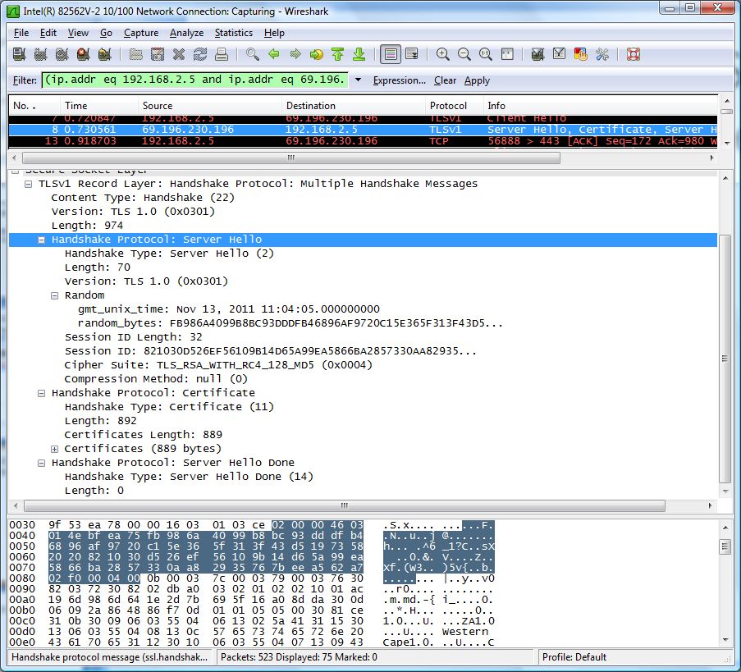
Walkthrough a TLS Connection: Server Hello through Hello Done
Multiple messages have “piggy” backed
Server Hello
Server Certificate
Server Hello Done
Server Hello
Selected RSA w/ RC4 and 128 bit MD5
No compression

Slide 34
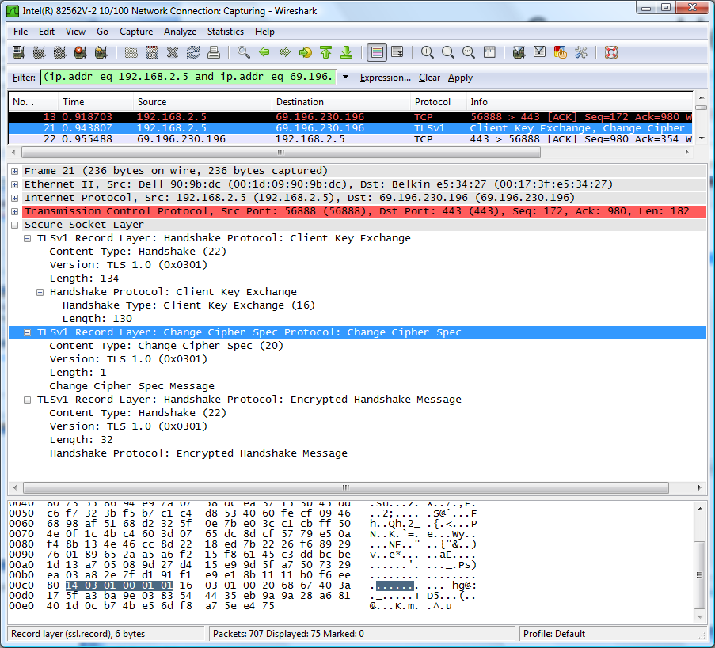
Walkthrough a TLS Connection: Client Key Exchange through Finish
Three TLS messages piggy backed onto the same TCP packet
Client Key Exchange
Change Cipher Spec
Client Finished

Slide 35
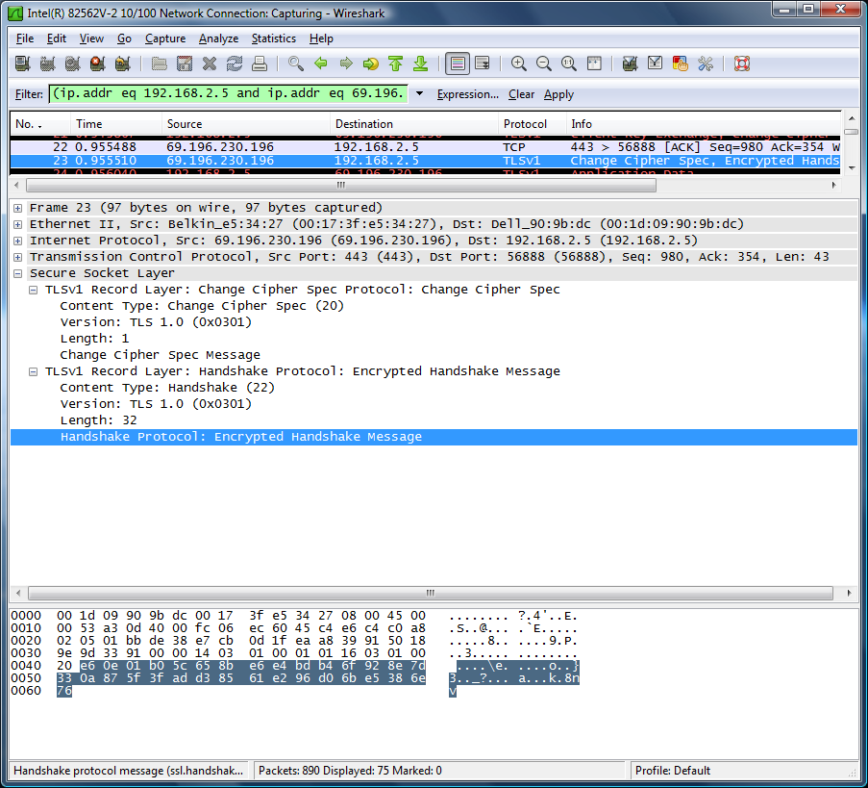
Walkthrough a TLS Connection: Server Key Exchange through Finish
Two Server TLS messages contained in TCP Packet
Server Change Cipher Spec
Server Finish

Slide 36
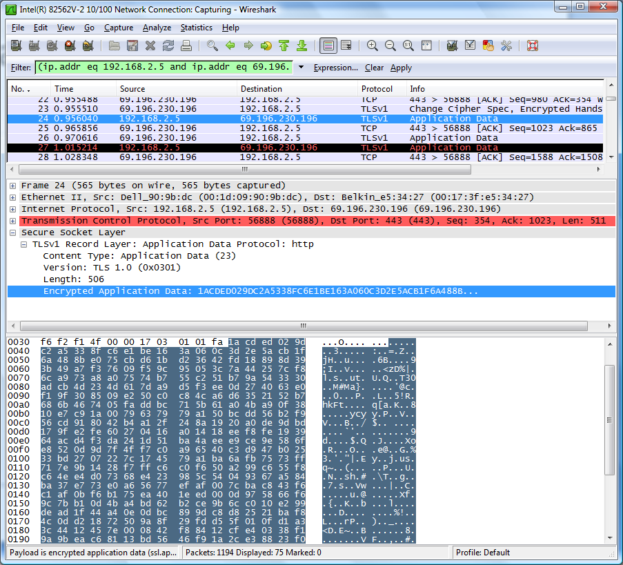
Walkthrough a TLS Connection: Sending/Receiving Data
Only the plaintext header is readable
Everything else is encrypted

Slide 37
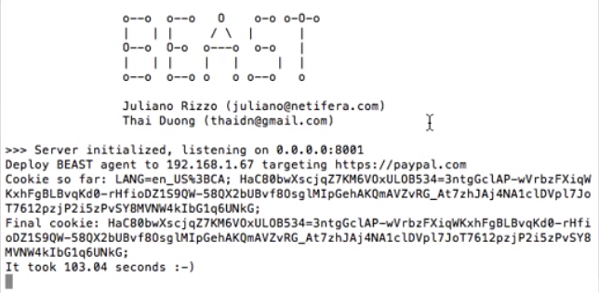
BEAST – Rizzo & Duong
Browser exploit against SSL/TLS (BEAST, 2009)
Techniques and a tool to exploit a previously known chosen plaintext vulnerability in SSL/TLS CBC modes
Original predictable IV in SSL/TLS 1.0
The IV for record j is CBC reside of j-1
CBC mode, means Ci = E(key, Ci-1 xor Mi)
If you can get (Cj-1 xor Ci-1 xor guessMi) encrypted
i.e. E(key, IV xor (Cj-1 xor Ci-1 xor guessMi)) = C’
Then if Ci = C’ your guess for Mi was correct
Notes:
Rizzo/Duong, Sifted the encryption boundaries to allow 1 byte to be guessed at a time. Used other web technologies (i.e. Java Applet) to send cross-origin traffic.

Slide 38
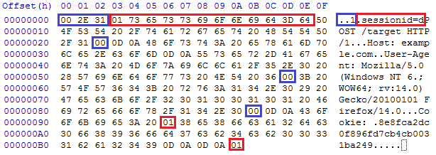
CRIME – Rizzo & Duong
Compression Ratio Info-leak Made Easy (2012)
Attacks SSL compression and SPDY
Basic compression method
Look for repeated strings, put into dictionary, replace occurrences with dictionary references
Length of encryption output identifies correct guess of data
E(M0 + secret + M1) = C’, Len(C’) = 10
E(M0 + secret + M1 + secret) = C’’, Len(C’’) = 6

Slide 39
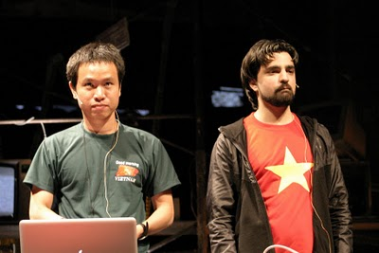
BREACH – Rizzo & Duong
Browser Reconnaissance and Exfiltration via Adaptive Compression of Hypertext (2013)
Attacks HTTP compression (gzip or DEFLATE)
Exploits compression similarly to CRIME
Use output sizes to (statistically) guess secrets
Mitigations
Randomize length?
Throttle and monitor traffic
Disable gzip/DEFLATE

